Slide 1
PROJECT TITLE
CAPSTONE PROJECT
Presented By: Manimela Sivakumar
Student Name : Manimela Sivakumar
College Name & Department : Narayana Engineering College
Gudur, 524101
Computer Science and Engineering

Slide 2
OUTLINE
Problem Statement
Technology used
Wow factor
End users
Result
Conclusion
Git-hub Link
Future scope

Slide 3
Problem Statement
Data security is a critical concern in the digital era, especially when transmitting confidential information. Traditional encryption methods can be complex and require external storage for encrypted files. This project implements a steganography-based secure data hiding system, allowing users to embed secret messages inside images while ensuring security through password-based authentication. The decryption process verifies the password, ensuring that only authorized users can access the hidden message.
Challenges Addressed:
✔ Difficulty in securely sharing sensitive messages. ✔ Risk of unauthorized access to hidden data. ✔ Lack of a user-friendly encryption method for non-technical users.

Slide 4
Technology used
Programming Language:
Python – Used for building encryption and decryption logic.
Libraries & Frameworks:
OpenCV (cv2) – Handles image processing and manipulation.
Tkinter – Creates a user-friendly GUI for encryption and decryption.
Hashlib – Provides SHA-256 hashing for password security.
Random & String Modules – Used for generating salts to enhance security.
Platforms:
Runs on Windows, Linux, and macOS with Python installed.

Slide 5
Wow factors
Dual-Layer Security: Combines steganography with SHA-256 password protection, ensuring only authorized access.
No Extra Storage Needed: Secret messages are embedded directly into images, eliminating the need for separate encrypted files.
User-Friendly Interface: A simple and intuitive GUI built with Tkinter makes encryption and decryption accessible to non-technical users.
Cross-Platform Compatibility: Runs seamlessly on Windows, Linux, and macOS without requiring complex installations.
Randomized Security Mechanism: Uses a unique salt for each encryption, making brute-force attacks extremely difficult.
Clipboard Integration: Automatically copies the decrypted message to the clipboard for easy retrieval.

Slide 6
End users
Individuals & General Users – Anyone looking for a simple and secure way to hide private messages in images.
Cybersecurity Enthusiasts – Users interested in learning about steganography and secure data transmission.
Journalists & Activists – People who need to communicate confidentially without raising suspicion.
Corporate Professionals – Businesses requiring secure internal communication without external encryption tools.
Students & Researchers – Those exploring cryptography, steganography, and data security in academic projects.

Slide 7
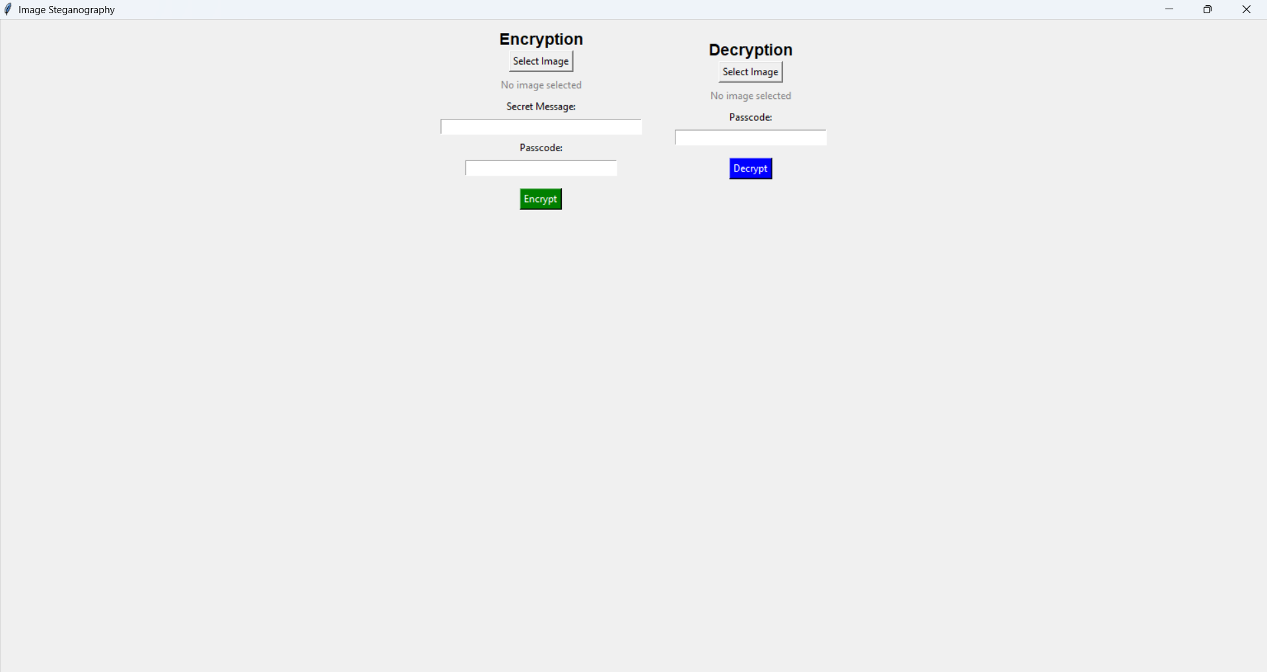
Results
Figure 1: Main Page

Slide 8
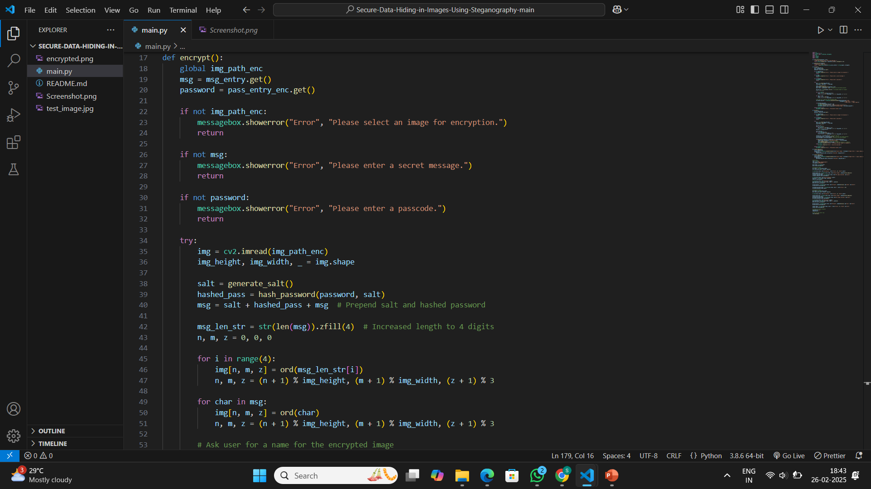
Figure 2: Encryption Code

Slide 9
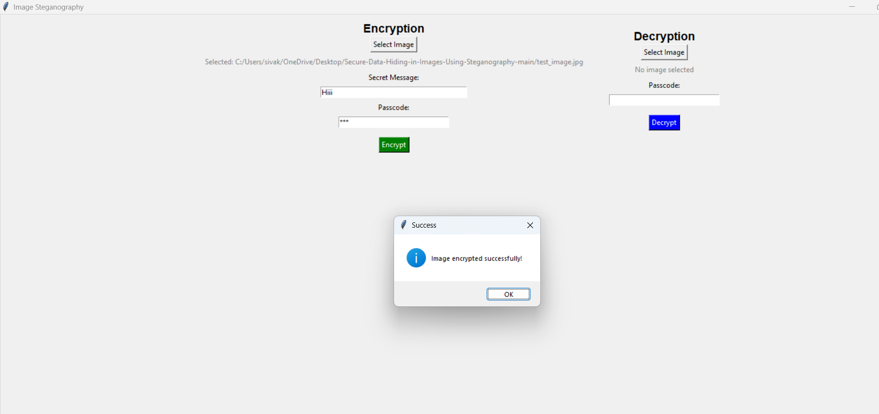
Figure 3: Encryption Output

Slide 10
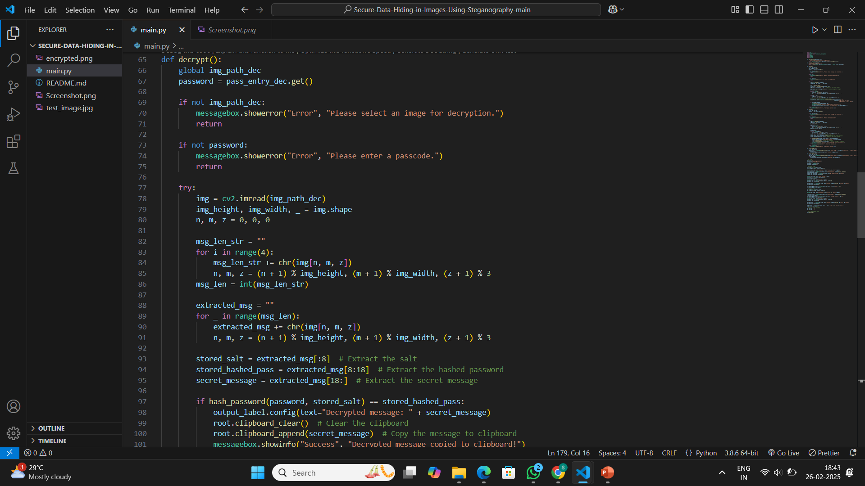
Figure 4: Decryption Code

Slide 11
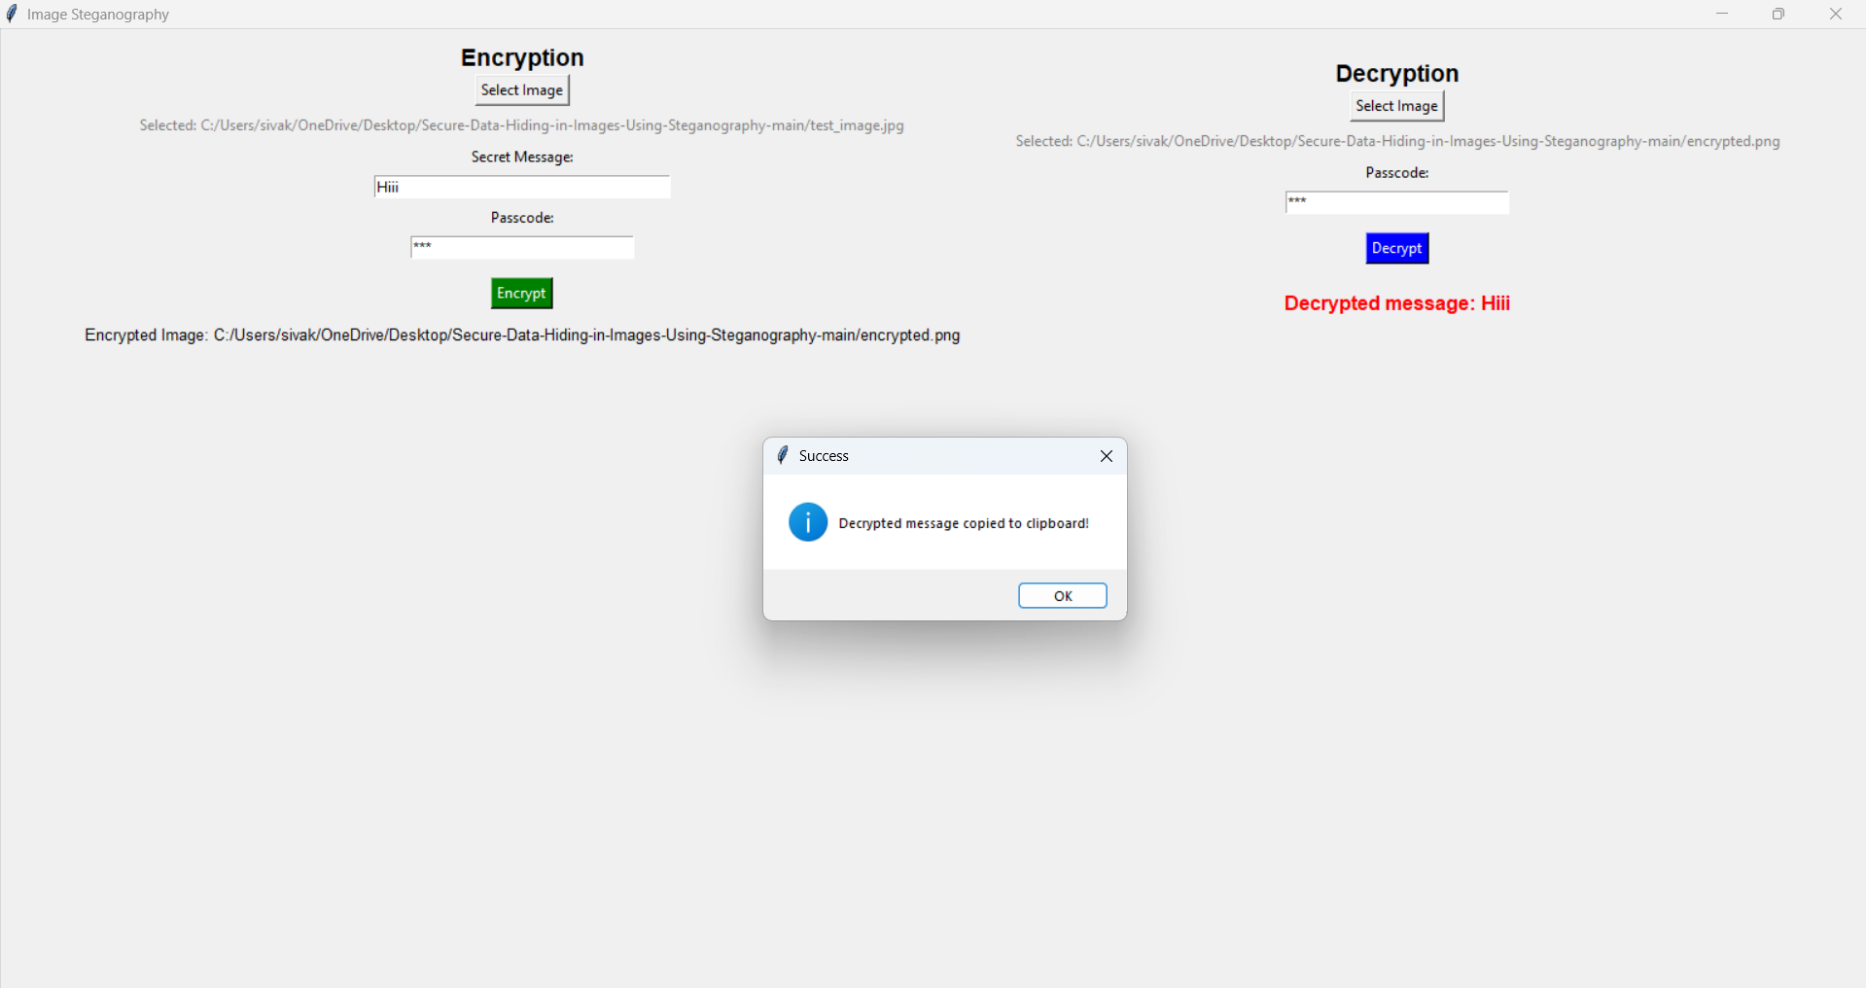
Figure 5: Decryption Output

Slide 12
Conclusion
This project provides a secure, efficient, and user-friendly solution for hiding sensitive data within images using steganography and cryptographic hashing.
By integrating SHA-256 password protection and randomized salting, it ensures enhanced security while maintaining simplicity for users.
The cross-platform compatibility and intuitive GUI make it accessible to both technical and non-technical users.
This system can be a valuable tool for secure communication, especially in scenarios where traditional encryption methods may be complex or impractical.
Secure Message Encryption – This project provides a simple yet effective way to securely encrypt messages within images using steganography and password protection.
Efficient Processing – The use of OpenCV and NumPy enables fast and efficient message embedding and extraction without significant image distortion.

Slide 13
GitHub Link
https://github.com/sivakumarmanimela/Secure-Data-Hiding-in-Image-Using-Steganography.git

Slide 14
Future scope(optional)
Enhanced Security – Implementing advanced encryption techniques like AES or RSA alongside steganography to strengthen security.
Support for Multiple File Types – Extending the system to hide and extract other file formats (e.g., PDFs, audio, and videos) within images.
AI-Based Steganalysis Prevention – Using AI to analyze image distortions and enhance the invisibility of hidden messages against steganalysis attacks.
Cloud Integration – Allowing users to encrypt and store steganographic images securely on cloud platforms for remote access.
Mobile Application Development – Creating an Android/iOS version of the system for wider accessibility and on-the-go secure communication.

Slide 15
THANK YOU

